Slide 1
Year 6 Science Knowledge Organiser Animals including humans Golden Thread: Freedom
Objectives and Sticky Knowledge
Prior Knowledge Recap: The main stages in a life cycle for animals, (including humans), are birth, growth, reproduction and death Exercise, a nutritious balanced diet and good hygiene are important for humans Humans have a skeletal and muscular system, and internal organs including ones in our digestive system and different teeth The changes in humans as they develop from birth to old age The process of reproduction in animals
Land Objectives/ Sticky Knowledge
Sea: Links with ‘Freedom’: | Links with CST and CKA Values Crown:
Identify and name the main parts of the human circulatory system | Know the function of the heart, blood vessels and blood | Know the impact of diet, exercise, drugs and lifestyle on health | Know the ways in which nutrients and water are transported in animals, including humans
- The system includes the heart, veins, arteries and blood transporting substances around the body. - Arteries carry oxygenated blood away from the heart. - Blood transports: • gases (mostly oxygen and carbon dioxide); • nutrients (including water); • waste products. | - Mammals have hearts with four chambers. - The blood that has come from the body is deoxygenated, and the blood that has come from the lungs is oxygenated again. - Oxygenated blood has more oxygen. It is pumped from the heart to the rest of the body. - Deoxygenated blood is blood where most of the oxygen has already been transferred to the rest of the body. - Veins carry deoxygenated blood toward the heart. | - Regular exercise: • strengthens muscles including the heart muscle; • improves circulation; • increases the amount of oxygen around the body; • releases brain chemicals which help you feel calm and relaxed; • helps you sleep more easily; • strengthens bones. - Drugs, alcohol and smoking have negative effects on the body. - A healthy diet involves eating the right types of nutrients in the right amounts. | - Know that the circulatory system transports nutrients around the body. - Know that water helps: • keep a normal temperature •lubricates and cushion joints • protects your spinal cord and other sensitive tissue • gets rid of wastes through urination, perspiration, and bowel movements

Slide 2
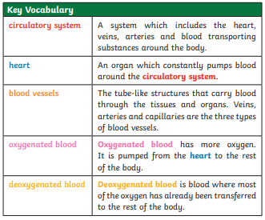
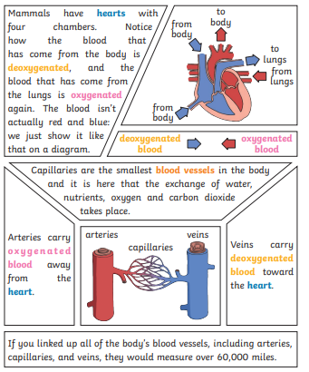
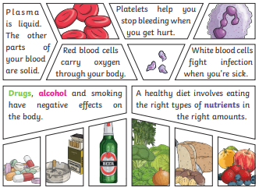
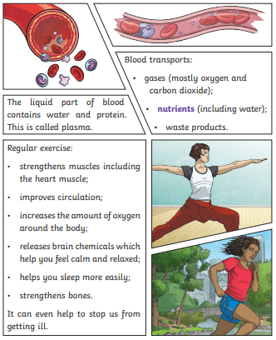
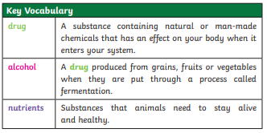
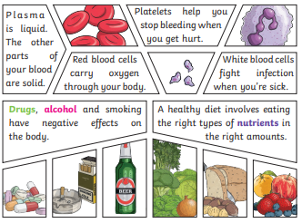
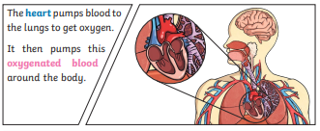
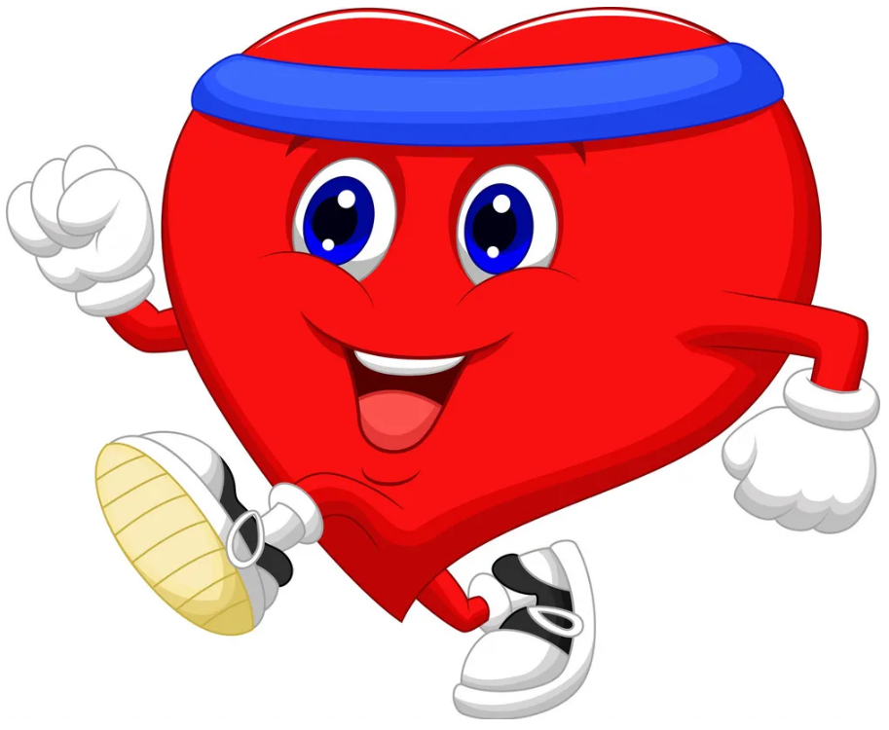
Year 6 Science Pentecost 2 Knowledge Organiser Animals including humans
Sky objectives:
1. Ask well-considered questions that closely match personalised enquiries.
2. Skilfully plan and conduct child-led investigations, deciding which variables to control and what observations to make.
3. Use personal knowledge combined with accurate observations and data collection to draw a conclusion.

