Slide 1
Year 6 Science Lent 2 & Pentecost 1 Knowledge Organiser Golden Thread: Sustainability & Freedom
Objectives and Sticky Knowledge
Prior Knowledge Recap: The main stages in a life cycle for animals, (including humans), are birth, growth, reproduction and death The life cycle of different living things e.g. mammal, amphibian, insect and bird and know the differences between these life cycles The process of reproduction in animals and plants How living things have been classified – The Linnaeus System
Land Objectives/ Sticky Knowledge
Sea: Links with ‘Sustainability and Freedom’: | Links with CST and CKA Values Crown:
Know how fossils can be used to find out about the past. | Know about reproduction and offspring (recognising that offspring normally vary and are not identical to their parents) | Know how animals and plants are adapted to suit their environment | Know about evolution and can explain what it is
- Fossils are preserved remains of ancient animals and plants. Fossils let scientists know how animals used to look millions of years ago. | - Animals and plants produce offspring that are similar but not identical. - You can see variation in any species, including plants. | Characteristics that are influenced by the environment the living things live in. These adaptations can develop as a result of many things, such as food and climate. | Evolution is the process by which different kinds of living organism have developed from earlier forms over millions of years. - Natural selection is a way by which animals have evolved to survive in their environments.

Slide 2
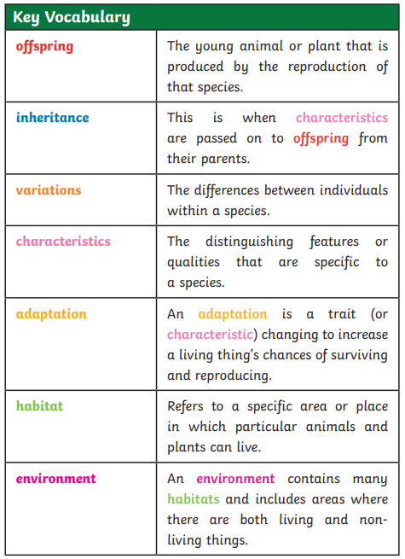
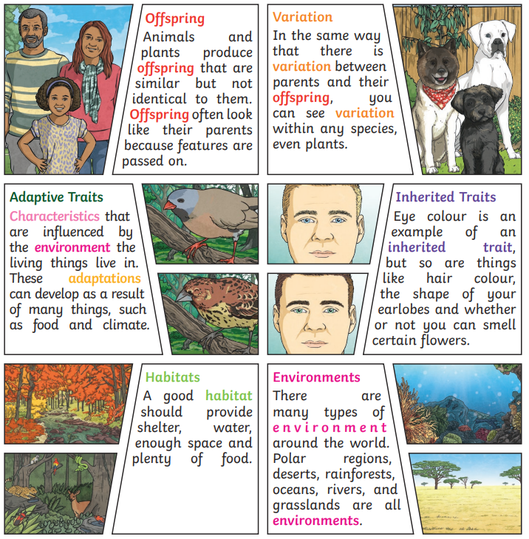
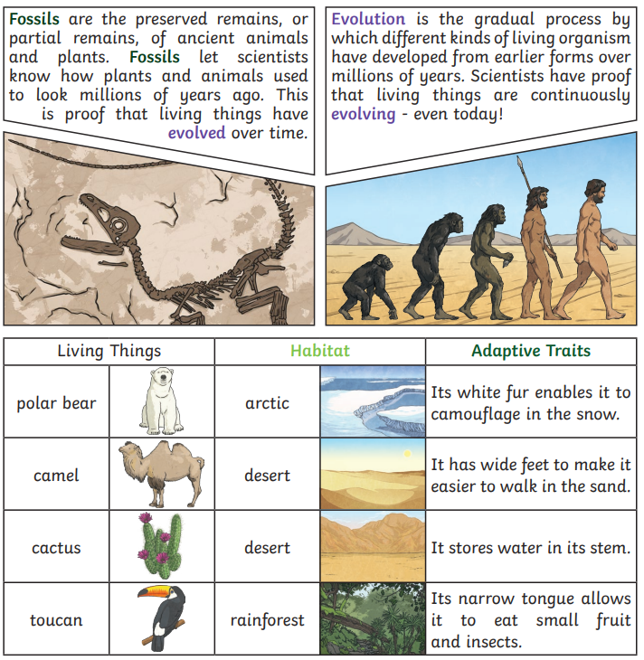
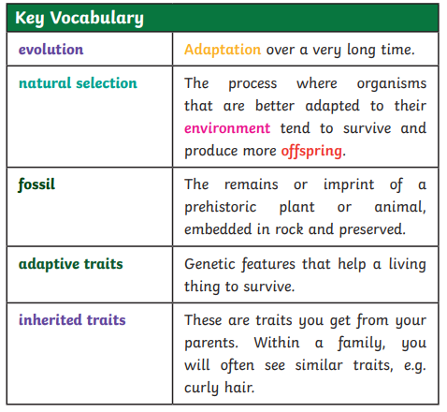
Year 6 Science Lent 2 and Pentecost 1 Knowledge Organiser Evolution & Inheritance
Sky objectives:
1. Ask well-considered questions that closely match personalised enquiries.
2. Skilfully plan and conduct child-led investigations, deciding which variables to control and what observations to make.
3. Use personal knowledge combined with accurate observations and data collection to draw a conclusion.

