Slide 1
Year 6 PSHE Pentecost 2 Knowledge Organiser The Working World In-App Purchases Golden Thread: Freedom
Objectives and Sticky Knowledge
Previous Knowledge Recap: The characteristics of healthy family life include: commitment to each other, including in times of difficulty, protection and care for children and other family members, spending time together and sharing each other’s lives. Enterprise is a project that requires boldness or energy. A company or organisation. Fundraising is to generate financial support for a charity, cause, or other enterprise.
Land Objectives/ Sticky Knowledge
Sea: Links with ‘Freedom’: | Links with CST and CKA Values Crown:
Know and understand various money-related terms | Recognise some of the ways in which we can spend money via technology | Describe the potential impact of spending money without permission | Identify strategies to save money
* Bank account * Loan * Tax * Interest * Debit card * Credit card * Wages * Debt * In-app purchases * Budget * Comparison * Fairtrade * Gambling See Key Vocabulary for definitions | In-app purchases Buying additional games Buying goods Memberships Sending people money | Your family must go without because they do not have enough money to pay for the things they need. (Food, heating, petrol, fun experiences etc.) You have lost your parents’ trust. You receive a consequence. (Being grounded, do not get any pocket money, cannot go online etc.) | Use less electricity Buy cheaper food Buy cheaper household items Buy less clothes and toys Shop in the sales Do activities that are free Recycle, reuse and repurpose

Slide 2
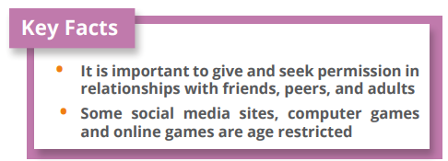
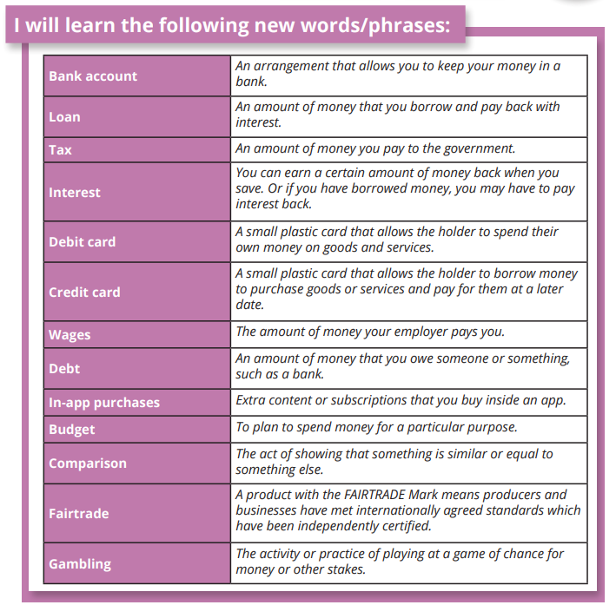
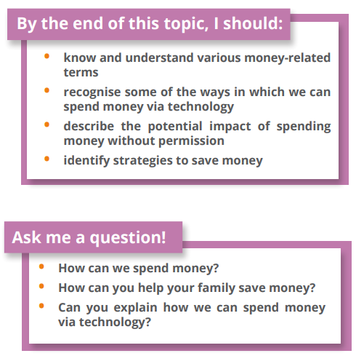
Year 6 PSHE Pentecost 2 Knowledge Organiser
The Working World In-App Purchases
Key Vocabulary
Sky objectives:
Children take responsibility for their emotions and actions, can recognise and discuss the feelings behind these and reflect on how they want to respond in the future.
Children recognise healthy relationships and what to do when a relationship becomes unhealthy.
Children know that to act responsibly helps to ensure the safety of themselves, others and the wider world.

