Slide 1
Year 6 PSHE Pentecost 2 Knowledge Organiser Feelings and Emotions - Worry Golden Thread: Freedom
Objectives and Sticky Knowledge
Previous Knowledge Recap: It is important to recognise and talk about your emotions There is a normal range of emotions (e.g. happiness, sadness, anger, fear, surprise, nervousness) and scale of emotions that all humans experience in relation to different experiences and situations It is important to judge whether what you are feeling and how you are behaving is appropriate and proportionate
Land Objectives/ Sticky Knowledge
Sea: Links with ‘Freedom’: | Links with CST and CKA Values Crown:
Recognise our thoughts, feelings, and emotions | Identify how we can reduce our feeling of worry | Explain how we can support others who feel worried | Recognise that we can choose how we act on our emotions and that our choices and actions can affect ourselves and other people
Listen to your body. Notice any changes to how your body feels. Describe how your body feels. Share how you feel. Name the emotions – Zones of Regulation. Share your thoughts. Recognising and naming your emotions is important in understanding how you feel and what you need to do to regulate yourself. | Speak to a trusted adult. Practice mindfulness / relaxation. Try to write down the positives. Make an envelope of worries. Repeat a positive mantra. “I am safe and protected.” “My fears do not control me.” “I choose peace over worry.” “I am in control of my thoughts.” “I am deserving of calm and happiness.” | Talk to them. Spend time with them so that they do not feel alone with their worries. Share a strategy that has helped you. Talk to a trusted adult on their behalf. Help them to co-regulate. | We cannot control how we feel but we can control how we act on those feelings. Being in control of your emotions allows you to control how you are around other people. Self-regulation is the ability to manage your emotions and behaviour in accordance with the demands of the situation.

Slide 2
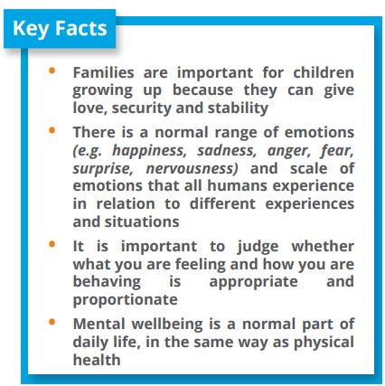
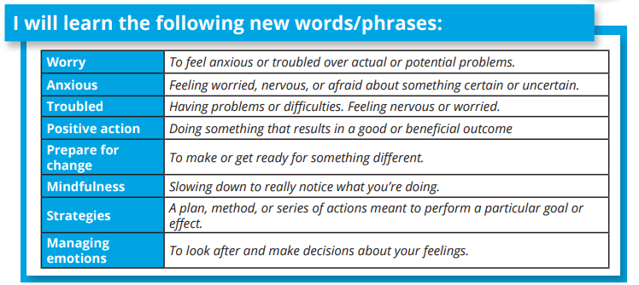
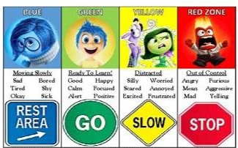
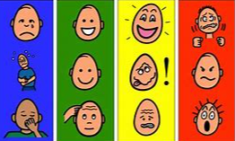
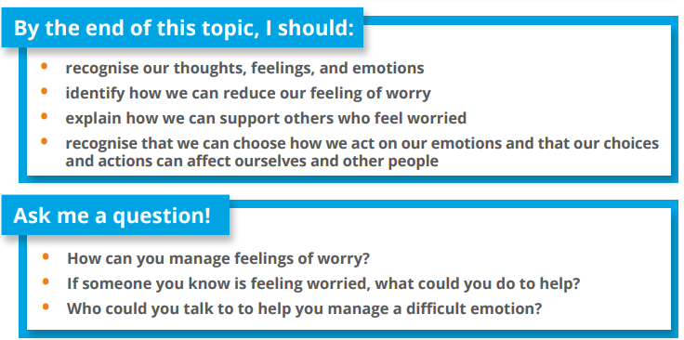
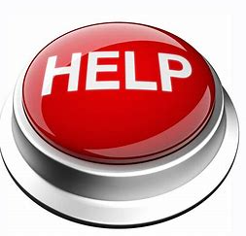
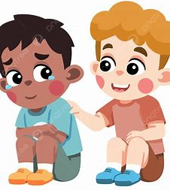
Year 6 PSHE Pentecost 2 Knowledge Organiser
Feelings and Emotions - Worry
Key Vocabulary
Sky objectives:
Children take responsibility for their emotions and actions, can recognise and discuss the feelings behind these and reflect on how they want to respond in the future.
Children recognise healthy relationships and what to do when a relationship becomes unhealthy.
Children know that to act responsibly helps to ensure the safety of themselves, others and the wider world.

