Slide 1
Year 6 PSHE Pentecost 1 Knowledge Organiser Growing and Changing - Puberty Golden Thread: Freedom
Objectives and Sticky Knowledge
Previous Knowledge Recap: It is not always right to keep secrets if they relate to being safe Each person’s body belongs to them It is important to seek help or advice if a relationship is making you feel unsafe or unhappy It is important to understand how to report concerns or abuse
Land Objectives/ Sticky Knowledge
Sea: Links with ‘Freedom’: | Links with CST and CKA Values Crown:
Explain what puberty means | Describe the changes that boys and girls may go through during puberty | Identify why our bodies go through puberty | Develop coping strategies to help with the different stages of puberty | Identify who and what can help us during puberty
Puberty is a phase of rapid growth, at the end of which the body reaches reproductive maturity. Other body systems mature during this time too. When the child matures physically and the reproductive system becomes active. When we go through puberty, we can experience physical and emotional changes. | The brain releases a hormone for puberty to begin. This hormone is called gonadotropin-releasing hormone. Boys and girls both go through puberty. Puberty can start between the ages of 8-17. Girls have periods which can last between 2-7 days. A wet dream is when semen is jaculated from the penis during sleep. Our moods can change during puberty. Sometimes we may have low moods for no reason. See detailed list of changes for girls and boys | Puberty is the process of physical changes through which a child’s body matures into an adult body capable of sexual reproduction. | Washing regularly and using deodorant can help manage the changes to our body odour. Having sanitary products in safe spaces will help. Know the importance of self-care and how to look after yourself physically, mentally, emotionally, spiritually and socially | Talking to trusted adults at home and school can help you understand what is happening and help you manage the different stages of puberty. Know the ‘Best 6 Doctors’ (Sunshine, Water, Rest, Air, Exercise and Diet).

Slide 2
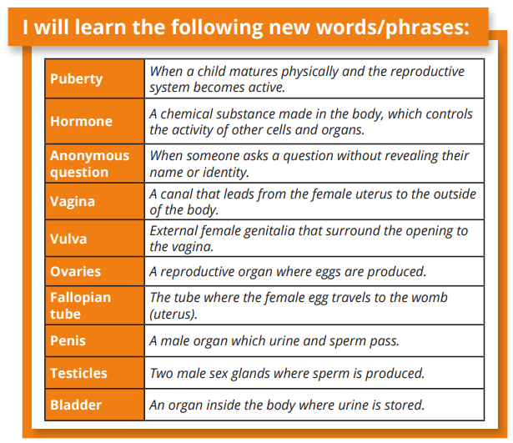
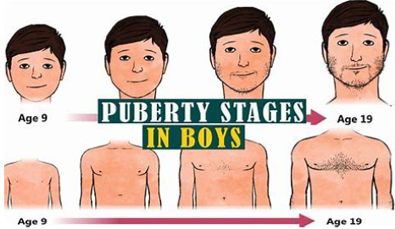
Year 6 PSHE Pentecost 1 Knowledge Organiser
Growing and Changing - Puberty
Key Vocabulary
Sky objectives:
Children take responsibility for their emotions and actions, can recognise and discuss the feelings behind these and reflect on how they want to respond in the future.
Children recognise healthy relationships and what to do when a relationship becomes unhealthy.
Children know that to act responsibly helps to ensure the safety of themselves, others and the wider world.

Slide 3
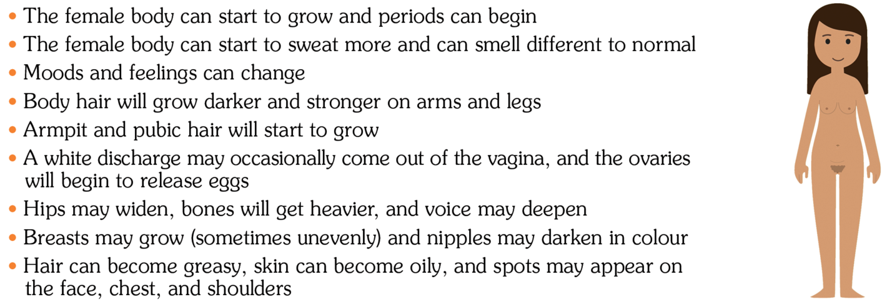
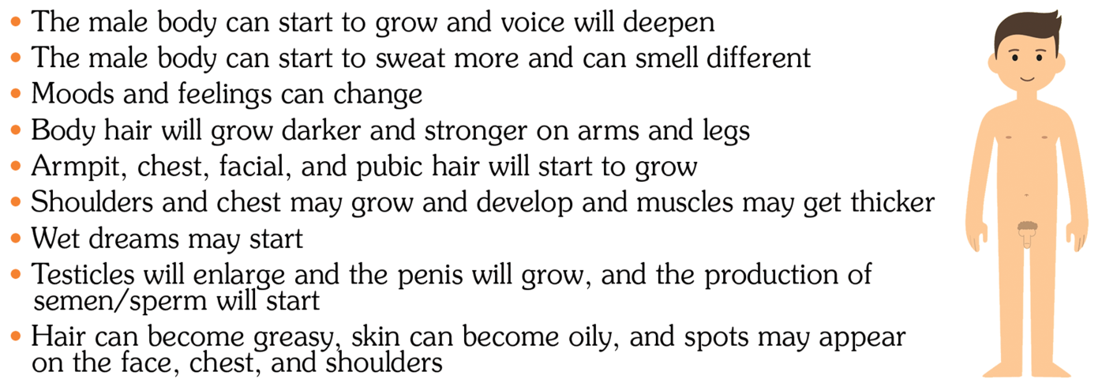
Year 6 PSHE Pentecost 1 Knowledge Organiser
Growing and Changing - Puberty

