Slide 1
Year 6 PSHE Pentecost 1 Knowledge Organiser Growing and Changing - Conception Golden Thread: Freedom
Objectives and Sticky Knowledge
Previous Knowledge Recap: When you go through puberty, you will experience physical and emotional changes There is a normal range of emotions (e.g. happiness, sadness, anger, fear, surprise, nervousness) and scale of emotions that all humans experience in relation to different experiences and situations There is advice available and steps we can take to support menstrual wellbeing
Land Objectives/ Sticky Knowledge
Sea: Links with ‘Freedom’: | Links with CST and CKA Values Crown:
Explain the terms ‘conception’ and ‘reproduction’ | Describe the function of the female and male reproductive systems | Identify the various ways adults can have a child | Explain various different stages of pregnancy | Identify the laws around consent
Conception is the process of conceiving a baby. Reproduction is the process by which living things create young or offspring. | Female * Ovaries * Fallopian tube * Womb (Uterus) * Cervix * Cervix (Internal) * Vulva (Extermal) Male * Foreskin * Penis * Vas Deferens (Ductus Deferens) * Uretha * Epididymis * Testicles See diagrams with each explained. | Sexual intercourse – The natural act to conceive a baby. IVF (In Vitro Fertilisation) - An egg is removed from the woman’s ovaries and fertilised with sperm in a laboratory and then returned to the woman’s womb. Donor egg – A woman becomes pregnant using an egg from a donor. Donor sperm – A woman becomes pregnant using sperm from a donor. Surrogacy – A woman agrees to carry the baby for the intended parents. | A pregnancy is divided into three trimesters, each lasting between 12-14 weeks. First trimester (0-13 weeks), second trimester (weeks 14-27) and the third trimester (weeks 28 – 40 or birth). Each trimester comes with its own specific hormonal and physiological changes. | The legal age of consent to have sex is 16. However, this should only happen when both people involved are comfortable and feel ready. Nobody should be forced to have sex.

Slide 2
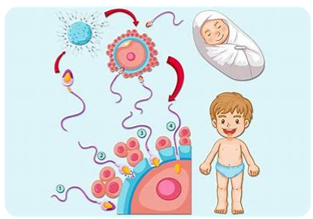
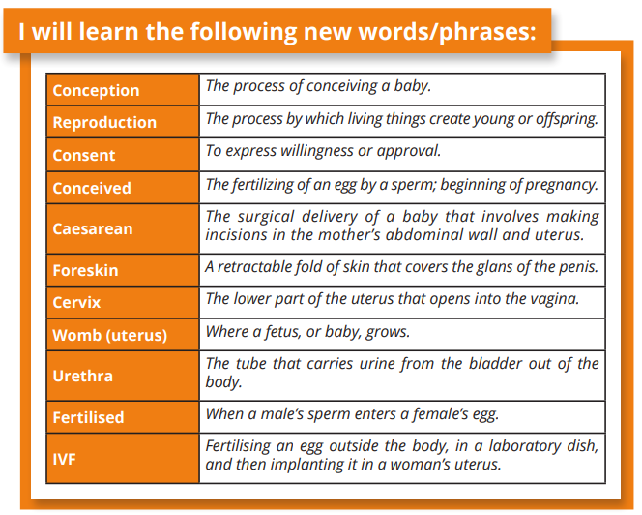
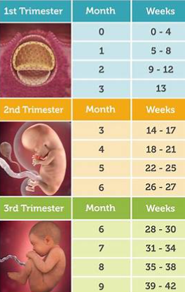
Year 6 PSHE Pentecost 1 Knowledge Organiser
Growing and Changing - Conception
Key Vocabulary
Sky objectives:
Children take responsibility for their emotions and actions, can recognise and discuss the feelings behind these and reflect on how they want to respond in the future.
Children recognise healthy relationships and what to do when a relationship becomes unhealthy.
Children know that to act responsibly helps to ensure the safety of themselves, others and the wider world.

Slide 3
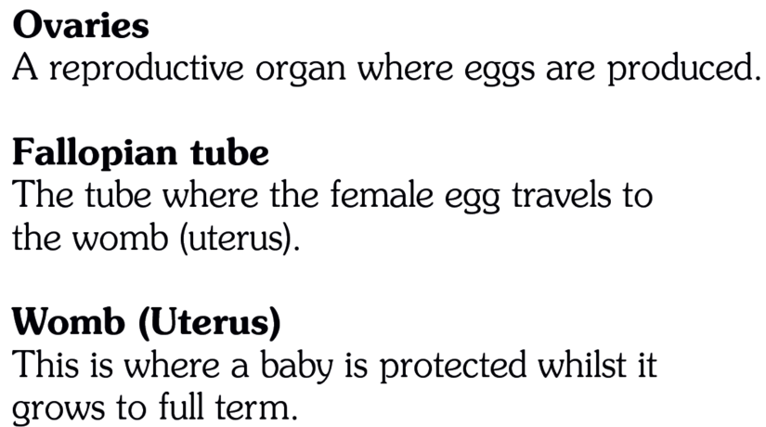
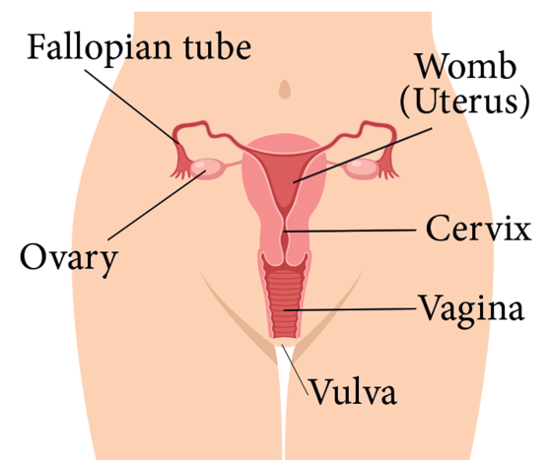
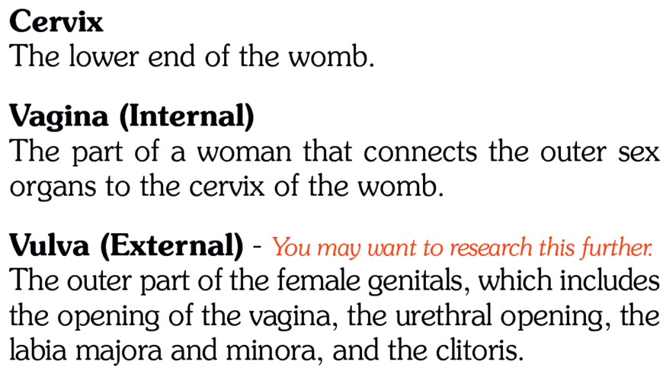
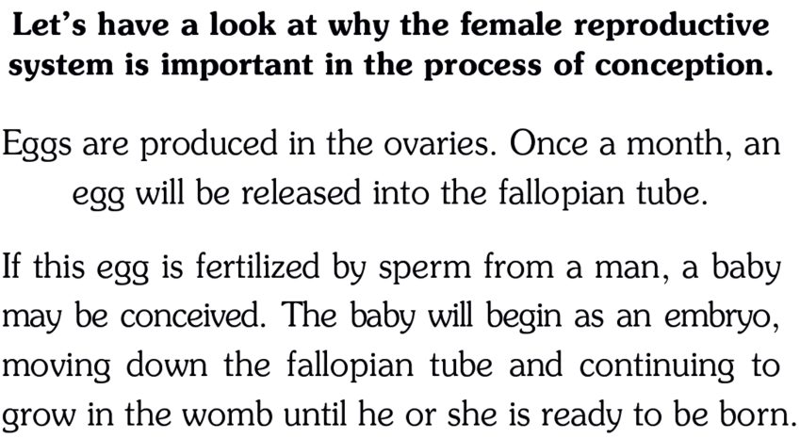
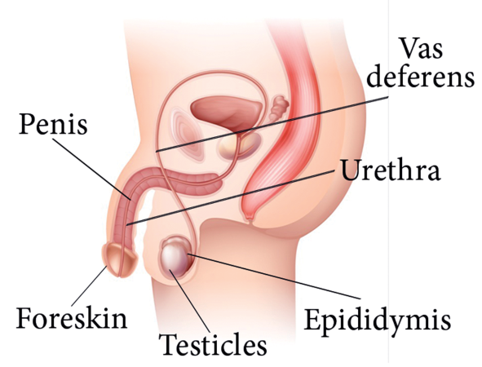
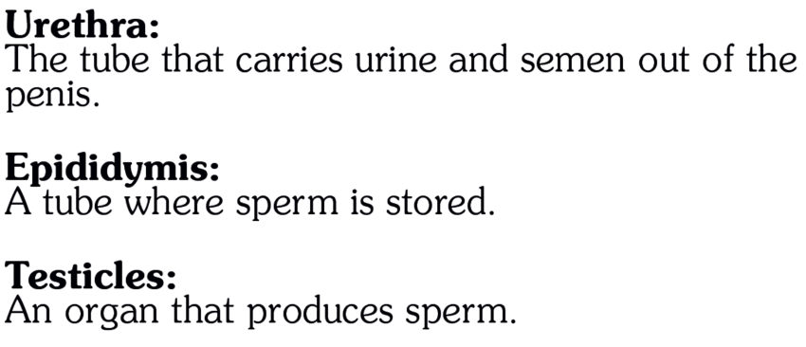
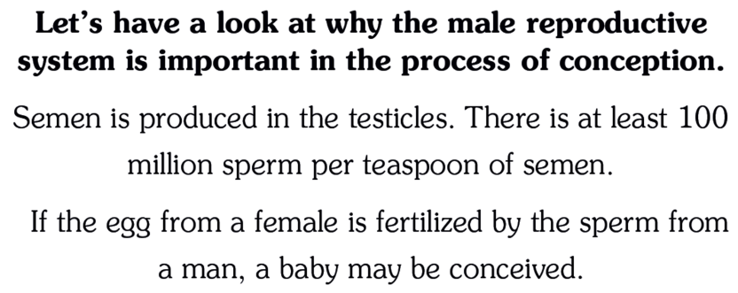
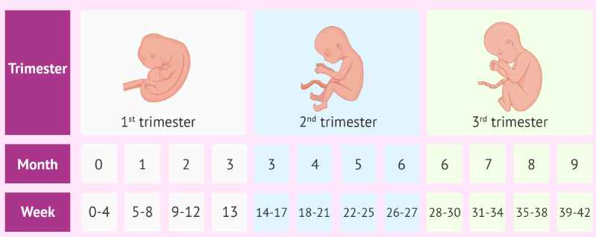
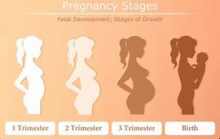
Year 6 PSHE Pentecost 1 Knowledge Organiser
Growing and Changing - Conception

