Slide 1
Year 6 OAA Knowledge Organiser Golden Thread: Freedom
Objectives and Sticky Knowledge
Prior Knowledge Recap: - It is important to throw and catch accurately with one hand- specifically using underarm and overarm throw - You need to vary tactics and adapt skills depending on what is happening in a game - Choose and adapt your techniques to keep possession and give their team a chance to shoot
Land Objectives and Sticky Knowledge:
Links with Golden Thread: | Links with CST and CKA Values Crown:
Follow a map into an unknown location | Use clues and a compass to navigate a route | Change route to overcome a problem
Locate start position on a map. Locate destination on a map. | Identify direction on a compass needed to travel. Identify key roads needed. Identify the fastest route and shortest route. | Find an alternative route that is efficient. Know how to navigate around a problem and then back to destination.

Slide 2
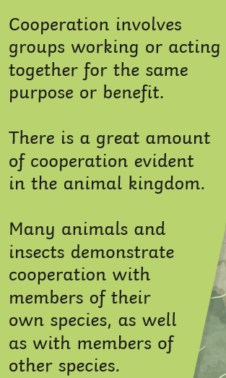
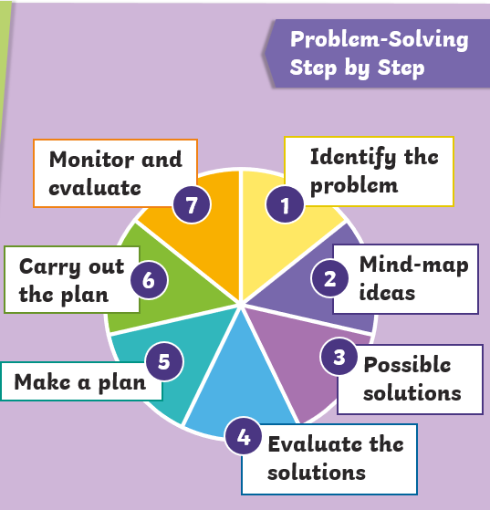
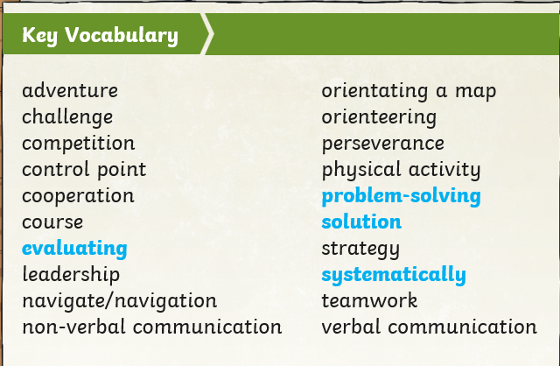
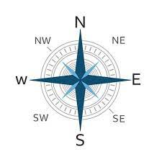
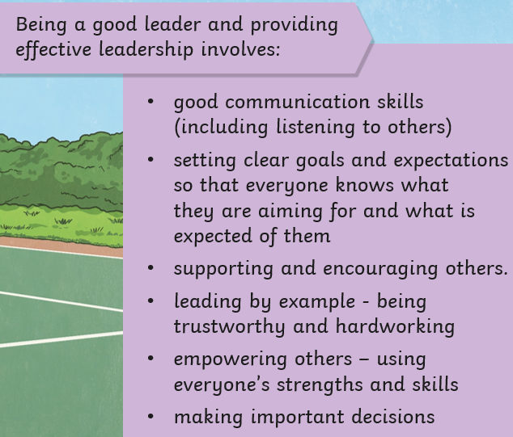
Year 6 OAA Knowledge Organiser
Key Vocabulary
Sky Objectives:
1. Can identify the correct technique for a sporting movement.
2.Can congratulate the opposing team when defeated in an activity.
3.Can describe what happens to our heart rate when exercising and how this effects our pulse.

