Slide 1
Year 6 Kwik Cricket Knowledge Organiser Golden Thread: Freedom
Objectives and Sticky Knowledge
Prior Knowledge Recap: - It is important to throw and catch accurately with one hand- specifically using underarm and overarm throw - You need to vary tactics and adapt skills depending on what is happening in a game - Choose and adapt your techniques to keep possession and give their team a chance to shoot
Land Objectives and Sticky Knowledge:
Links with Golden Thread: | Links with CST and CKA Values Crown:
Pick up on something a partner does well and also on something that can be improved – focus on catching skills. | Know why own performance was better or not as good as their last.
Watch the ball and get into the best position to receive the catch. With palms facing upwards, cup your hands so your little fingers are touching and your fingers are spread out. Keep your hands at eye level and your elbows bent. As the ball makes contact, close your hands around it. | Be able to identify the features of the WAGOLL for each skill. Evaluate your own personal performance against each skill. Be able to listen to feedback on how to improve performance.

Slide 2
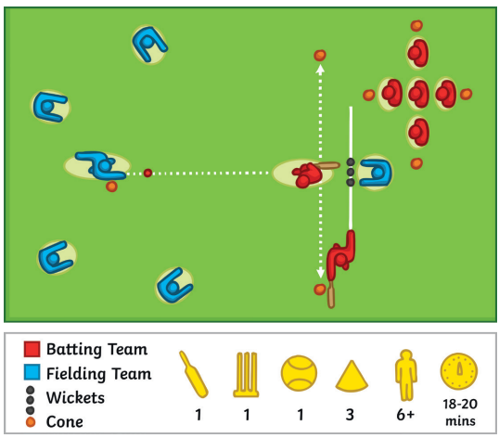
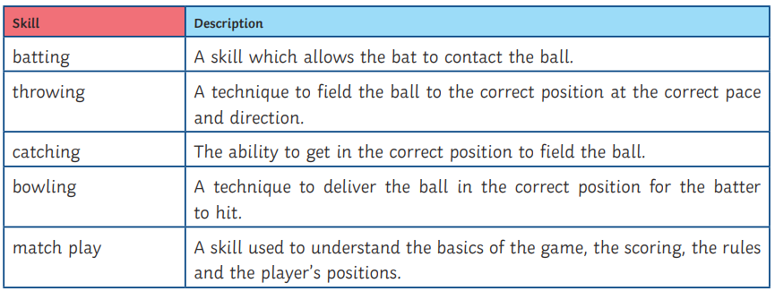
Year 6 Kwik Cricket Knowledge Organiser
Key Vocabulary
Sky Objectives:
1. Can identify the correct technique for a sporting movement.
2.Can congratulate the opposing team when defeated in an activity.
3.Can describe what happens to our heart rate when exercising and how this effects our pulse.

