Slide 1


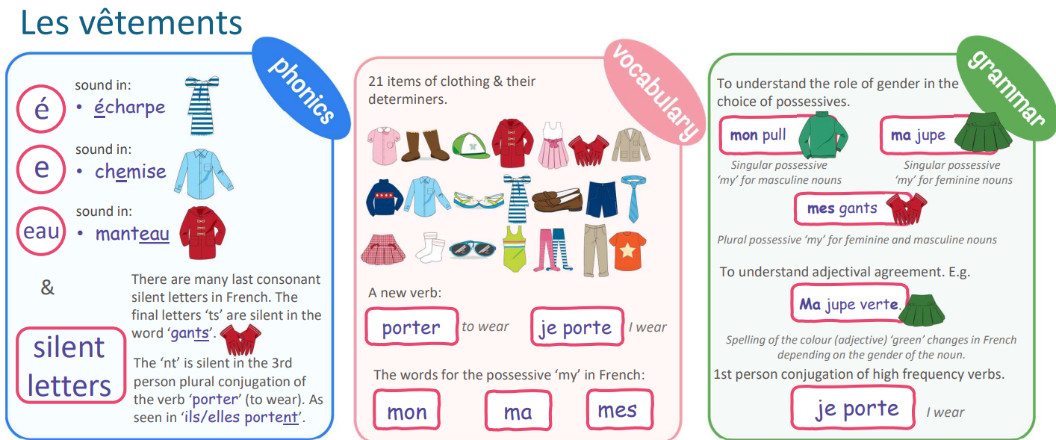
Year 6 French Pentecost 1 Knowledge Organiser Golden Thread: Freedom
Objectives and Sticky Knowledge
Sky objectives: 1. Converse briefly without prompts (4 exchanges each) 2. Read and write several sentences from memory 3. Present information about an aspect of another country
Sea: Links with Golden Thread: | Links with CST and CKA Values Crown:

Slide 2
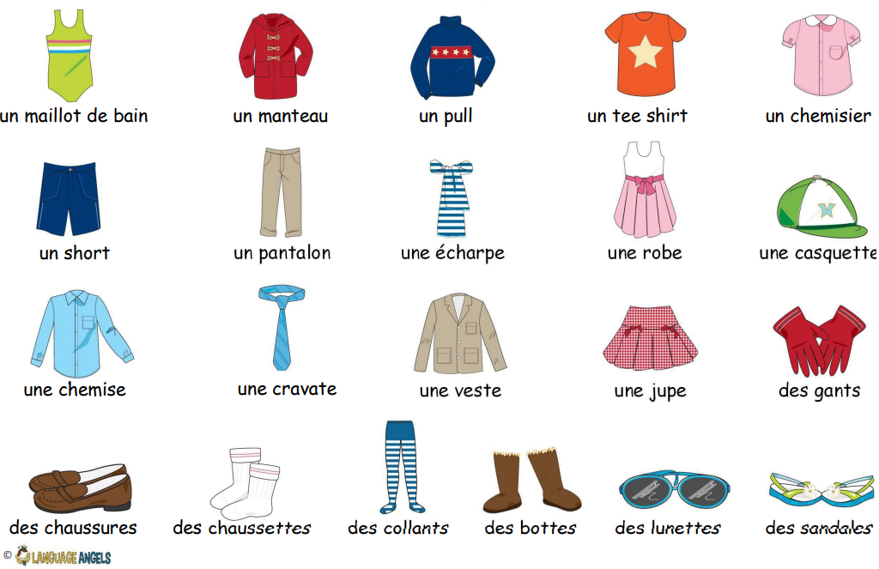
Year 6 French Knowledge Organiser

