Slide 1
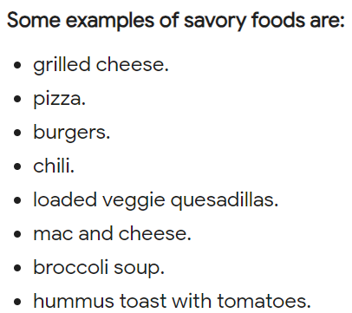
Year 6 Design Technology Pentecost 2 Knowledge Organiser Golden Thread: Freedom
Objectives and Sticky Knowledge – Come Dine with Me
Previous Knowledge Recap: I can use correct tools safely. I can identify key design features. I can say how my design has been successful.
Land Objectives and Sticky Knowledge:
Sea: Links with ‘Freedom’: | Links with CST and CKA Values Crown:
Explain how food ingredients should be stored and give reasons. | Work within a budget to create a meal. | Understand the difference between a savoury and sweet dish.
Foods should be stored in the refrigerator as soon as possible after purchase or preparation to slow down the growth of bacteria. The refrigerator’s temperature should be set at 4°C or below to keep food safe. Raw meats, poultry, and fish should be stored in separate containers from ready-to-eat foods to prevent cross-contamination. This will help to prevent the spread of bacteria from raw food to other foods. Foods should be stored in airtight containers or wrapped properly to prevent contamination from other foods or from the environment. Label and date all food items with the name of the food and the date it was stored. This will help you keep track of when food should be consumed or thrown out to prevent spoilage. Different foods need to be stored at different temperatures to ensure their safety. Foods that require refrigeration should be stored at 4°C or below while frozen foods should be stored at -18°C or below. | Choose foods from each food group. Make sure you have enough food for a week. Stick to the budget you have been set. | Some examples of savoury foods are: - chocolate - sweets - fruit - biscuits - cake

Slide 2
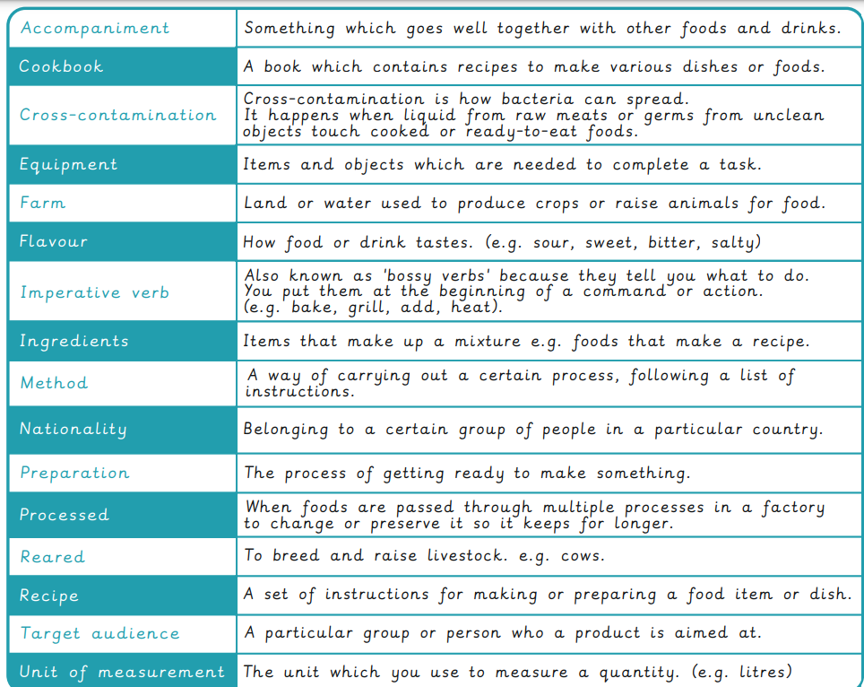
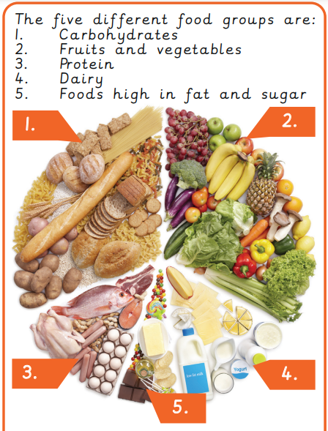
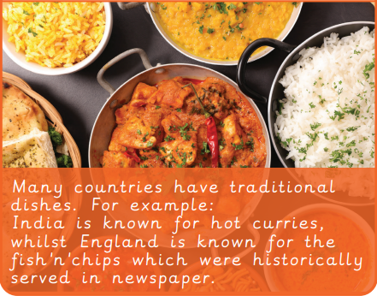
Year 6 Design Technology Pentecost Knowledge Organiser
Sky Objectives:
1. Designing a stable structure able to support its own weight, with focus on triangulation
2. Select appropriate tools and equipment for particular tasks, using these safely and accurately e.g. saws.
3. Suggesting points for improvements for own design and those designed by others

