Slide 1
Year 6 Pentecost 2 Computing Knowledge Organiser Golden Thread: Freedom
Objectives and Sticky Knowledge – Programming B
Previous Knowledge Recap: 1. I know that permission is needed when recording another person. 2. I know that videos of other people must not be shared anywhere without the person’s consent, or consent of an adult.
Land Objectives and Sticky Knowledge:
Sea: Links with Freedom: | Links with CST and CKA Values Crown:
To explain that selection can control the flow of a program. | To update a variable with a user input | To use an conditional statement to compare a variable to a value
I can identify examples of conditions in the real world I can use a variable in an if, then, else statement to select the flow of a program I can determine the flow of a program using selection | I can use a condition to change a variable I can experiment with different physical inputs I can explain that checking a variable doesn’t change its value. | I can use an operand (e.g. <>=) in an if, then statement I can explain the importance of the order of conditions in else, if statements I can modify a program to achieve a different outcome

Slide 2
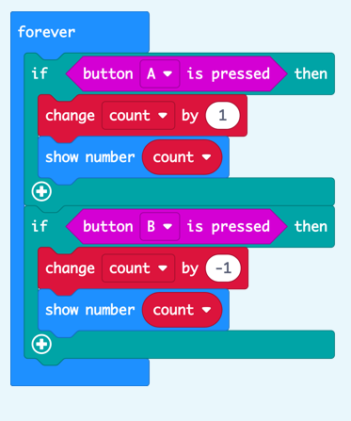
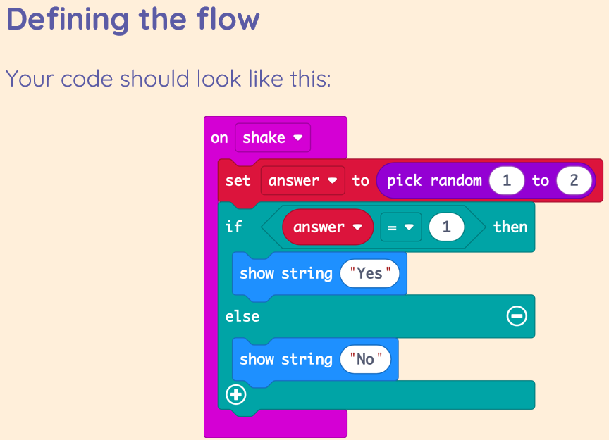
Year 6 Computing Pentecost 2 Knowledge Organiser
Sky Objectives:
Use variables in programs in order to influence a value.
Collect, present and evaluate data that is easily understandable to a given audience.
Demonstrate the safe and respectful use of a broad range of technologies grounded in the understanding of the importance of privacy, consent and respect.

