Slide 1
Year 6 Pentecost 1 Computing Knowledge Organiser Golden Thread: Freedom
Objectives and Sticky Knowledge – Programming A
Previous Knowledge Recap: 1. I know that permission is needed when recording another person. 2. I know that videos of other people must not be shared anywhere without the person’s consent, or consent of an adult.
Land Objectives and Sticky Knowledge:
Sea: Links with Freedom: | Links with CST and CKA Values Crown:
To explain why a variable is used in a program | To choose how to improve a game by using variables. | To use my design to create a project
I can identify a program variable as a placeholder in memory for a single value. I can explain that a variable has a name and a value. I can recognise that the value of a variable can be changed. | I can decide where in a program to change a variable. I can make use of an event in a program to set a variable. I can recognise that the value of a variable can be used by a program. | I can create the artwork for my project. I can choose a name that identifies the role of a variable. I can test the code that I have written.

Slide 2
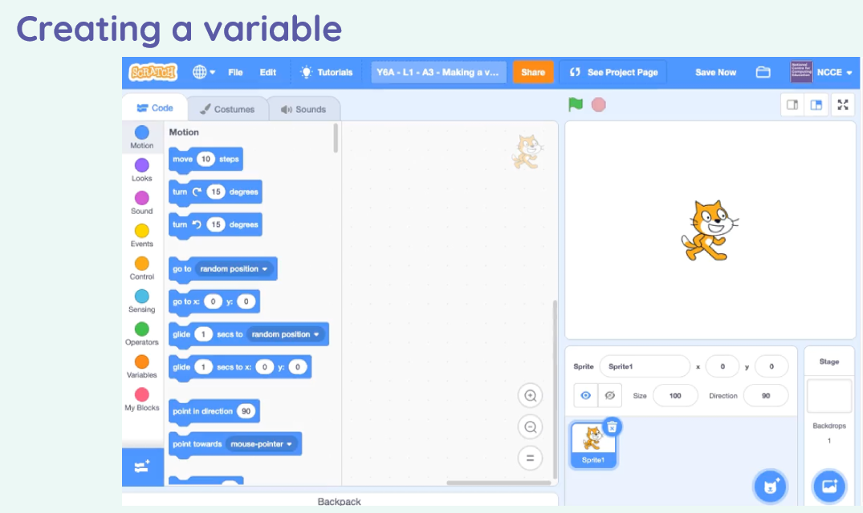
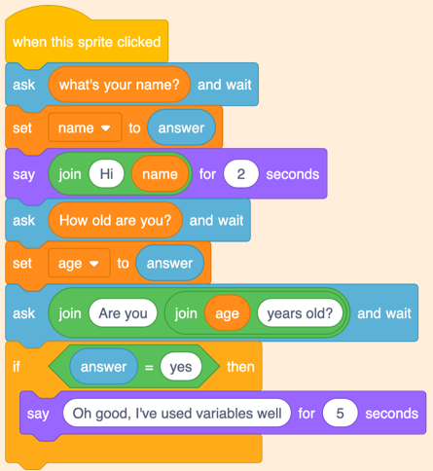
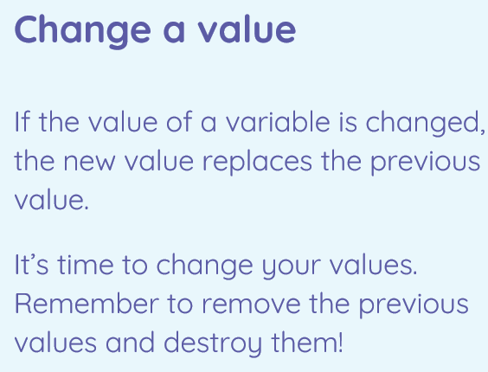
Year 6 Computing Pentecost 1 Knowledge Organiser
Sky Objectives:
Use variables in programs in order to influence a value.
Collect, present and evaluate data that is easily understandable to a given audience.
Demonstrate the safe and respectful use of a broad range of technologies grounded in the understanding of the importance of privacy, consent and respect.

