Slide 1
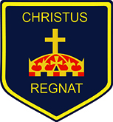
Year 6 The Maya Knowledge Organiser Golden Thread: Freedom
Objectives and Sticky Knowledge
Previous Knowledge Recap: -Britain stood alone at the start of WW2 as other European countries fell to the Nazis. - The British, together with their allies, defeated Hitler the impact this had on the world and core values such as freedom. - WW1 ended and key events leading up to the start of WW2. - The key political figures from WW2 were Hitler, Chamberlain, Churchill. -Know how WW2 began including key territory taken and the significance of Dunkirk. - The decision of Hitler and Goring to invade Britain by air was ultimately key in events leading up to the Battle of Britain. -Know key details about the Battle of Britain – when? What happened? Why significant?
Land Objectives and Sticky Knowledge:
Links with Golden Thread: | Links with CST and CKA Values Crown:
- I can explain the religious beliefs of the Maya people, understand how they worshipped, name some of the main gods and know what they represented to the people. | - I can understand how the Maya number system works. | - I can explain what the Mayan writing system consists of, how words are constructed and what codices are. | - I can describe a range of foods that were eaten by the ancient Maya people and explain why certain foods were particularly significant.
- Gods and goddesses had a good and bad side and they could help or hurt them. - The Maya people would sing, dance and make offerings. - Priests communicated directly with gods and goddesses and as a result, priests were very important in society. | - The Maya developed an advanced number system for their time. - They were one or two cultures in the world to develop the concept of zero as a placeholder. - The number system used three symbols in different combinations. | - The writing system was used to write several different Maya languages. - It was made up of many symbols, called glyphs. - Logograms are glyphs representing whole words. - Syllabograms are glyphs representing syllables. - The glyphs were carved on stone buildings and monuments and painted on pottery. - Maya scribes also wrote books called codices. | - The Maya people mainly ate maize. - Maize was very important to them as they believed that the first humans were made from maize dough by the gods. - The Maya made a bitter chocolatey drink from cacao beans, enjoyed by the rich. - Cacao beans were used for medicines and in ceremonies and were highly valued and used as a form of money.

Slide 2
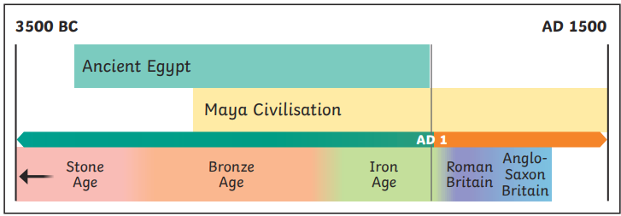
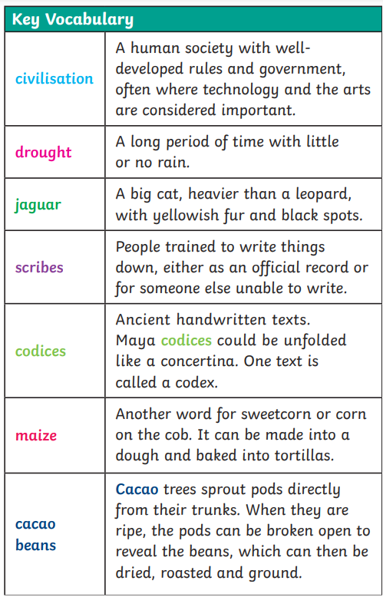
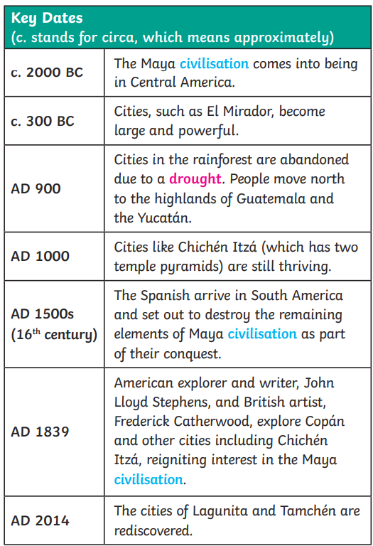
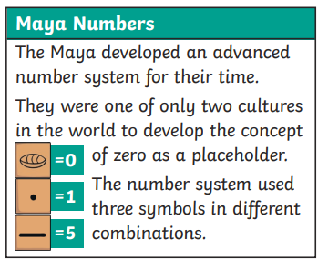
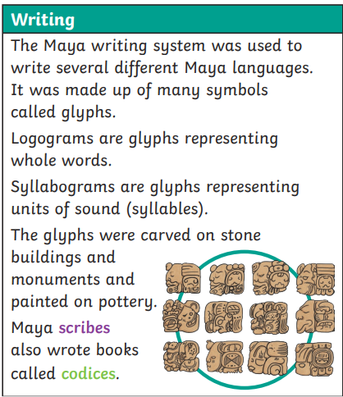
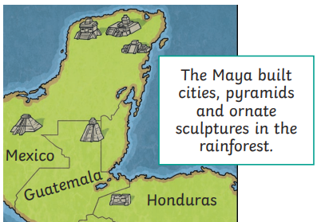
Year 6 The Maya Knowledge Organiser
Key Vocabulary
Sky Objectives:
1. Select relevant sources of information to address historically valid questions and construct detailed, informed responses.
2. Using appropriate historical terms, describe the key features of the past, including attitudes, beliefs and the everyday lives of men, women and children.
3. Understand and describe in some detail the main changes to an aspect in a period in history and how some events / periods occurred concurrently in different locations.

