Slide 1
Year 2 Science – Plants - bulbs and seeds Golden Thread: Freedom
Objectives and Sticky Knowledge
Previous Knowledge Recap:
Land Objectives and Sticky Knowledge:
Links with Golden Thread: | Links with CST and CKA Values Crown: Stewardship – caring for God’s gifts Thinking of everyone – the common good
Know and name a variety of common wild and garden plants.
Know and name the petals, stem, leaves and root of a plant.
Know and name the roots, trunk, branches and leaves of a tree.
Know and explain how seeds and bulbs grow into plants. | Know what plants need in order to grow and stay healthy (water, light & suitable temperature)
I can explain that the plant begins as a seed or bulb. I can explain that the seed germinates and grows roots. As the plant grows, it develops leaves. The plant then grows flowers or fruit. Seeds are dispersed by the wind or by insects. The parent plant begins to die and the seeds that have been dispersed begin to grow. | I know that plants need water, sunlight and the right temperature to grow.

Slide 2
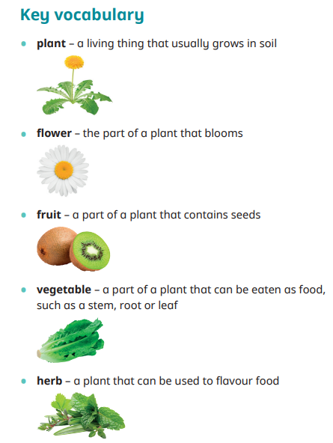
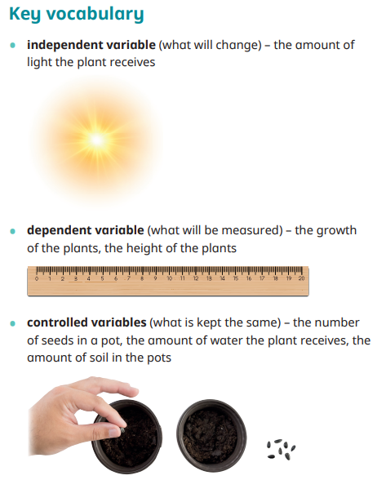
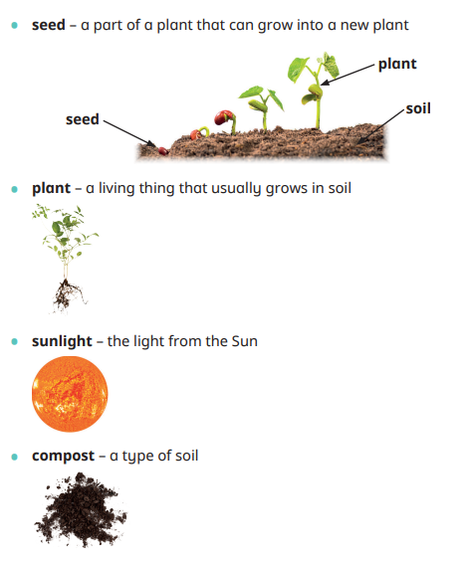
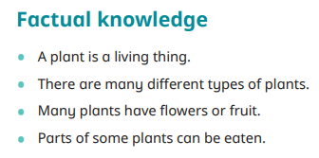
Year 2 Science – Plants – bulbs and seeds Golden Thread: Freedom
Sky Objective: Begin to pass comment on what has happened in a simple investigation.

