Slide 1
Year 2 Science – Growing up Golden Thread: Freedom
Objectives and Sticky Knowledge
Previous Knowledge Recap: Know how to sort living and non-living things
Land Objectives and Sticky Knowledge:
Links with Golden Thread: | Links with CST and CKA Values Crown: Stewardship – caring for God’s gifts Thinking of everyone – the common good
Know the basic stages in a life cycle for animals, (including humans)
Know some animals give birth to live young Some animals lay eggs that the young hatch from Some offspring look like their adults and others go through metamorphosis

Slide 2
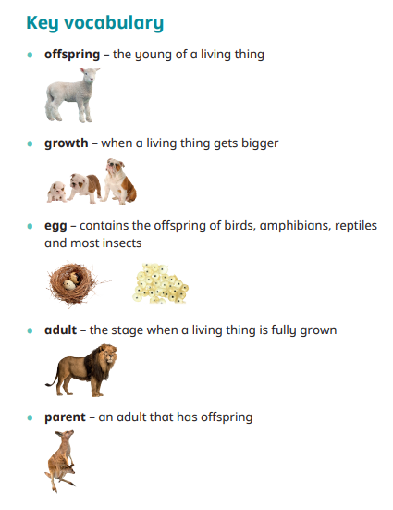
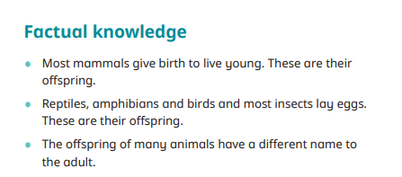
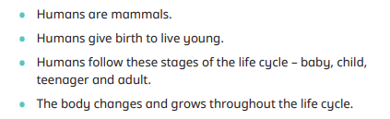
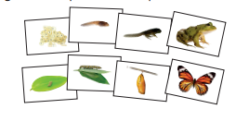
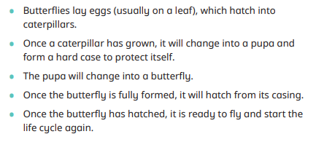
Year 2 Science – Growing up Golden Thread: Freedom
Sky Objective: Begin to pass comment on what has happened in a simple investigation.

