Slide 1
Year 2 PHSE – Feelings and Emotions Golden Thread: Freedom
Objectives and Sticky Knowledge
Begin to know the difference between pleasant and unpleasant emotions and begin to know some coping mechanisms.
Land Objectives and Sticky Knowledge:
Links with Golden Thread | Links with CST and CTK values:
Previous Knowledge:
I can recognise and name emotions, describing their physical effects and suggest some coping strategies.
I can recognise and name a range of emotions and describe their physical effects. I know whether they are pleasant or unpleasant emotions. I have some coping skills for dealing with unpleasant/uncomfortable

Slide 2
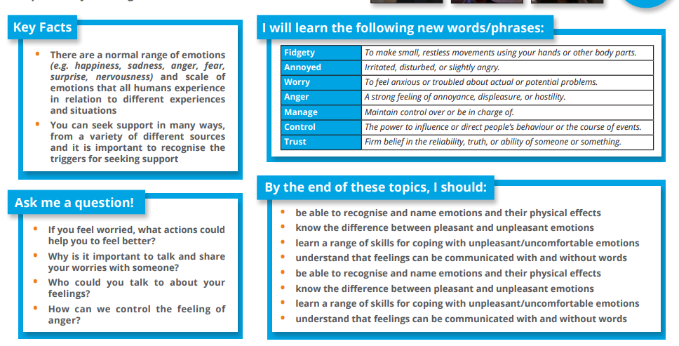
Year 2 PHSE – Feelings and Emotions Golden Thread: Freedom
Sky Objectives:
Children start to accurately name the different feelings they experience.

