Slide 1
Year 2 PE – Team Games Golden Thread: Freedom
Objectives and Sticky Knowledge
Previous Knowledge Recap Follow rules. Know how to play as part of team.
Land Objectives and Sticky Knowledge:
Links with Golden Thread: | Links with CST and CKA Values Crown:
Use hitting, kicking and/or rolling in a game | Decide the best space to be in during a game | Use a tactic in a game | Follow rules
Know that kicking, rolling and hitting can be used in different games. Know that different kicks and rolls can distract the opponent. Know that coordination is important to improve accuracy when hitting, kicking and rolling. | Use the space of the playing area Think about where you need to be on the playing area | Understand that a tactic is something that your team can use as an advantage. Know that tactics can be used in different ways. | Know what a rule is and how we can follow rules. Understand why rules are important.

Slide 2
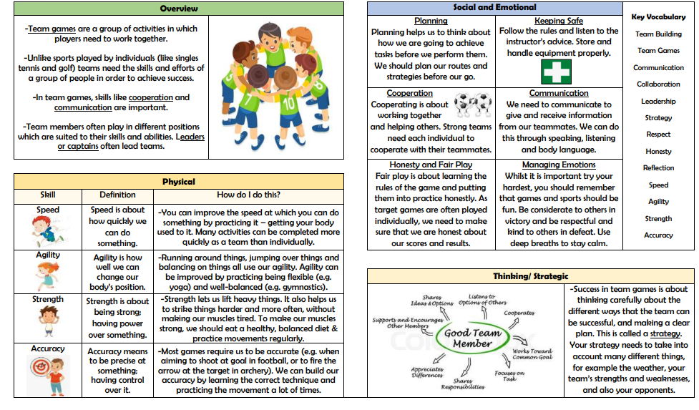
Year 2 PE – Team Games Golden Thread: Freedom
Sky Objectives:
Can describe the ABC’s relating to movement.
Can join teams without any problems during an activity.
Can identify why our bodies sweat and how this effects our need for water.

