Slide 1
Year 2 PE – Dance Golden Thread: Freedom
Objectives and Sticky Knowledge
Previous Knowledge Recap Perform own dance move Copy or make up a short dance Move safely in a space
Land Objectives and Sticky Knowledge:
Links with Golden Thread: | Links with CST and CKA Values Crown:
Change rhythm, speed, level and direction in dance. | Make a sequence by linking sections together | Use dance to show a mood or feeling.
Know that changing rhythm, direction and speed in your dance can have a positive impact on the dance Know that co-ordination means controlling the way you move | Know that linking something means joining together. (e.g. linking movements together to make a short dance) | Understand that mood and feelings can be expressed through the way we move in dance

Slide 2
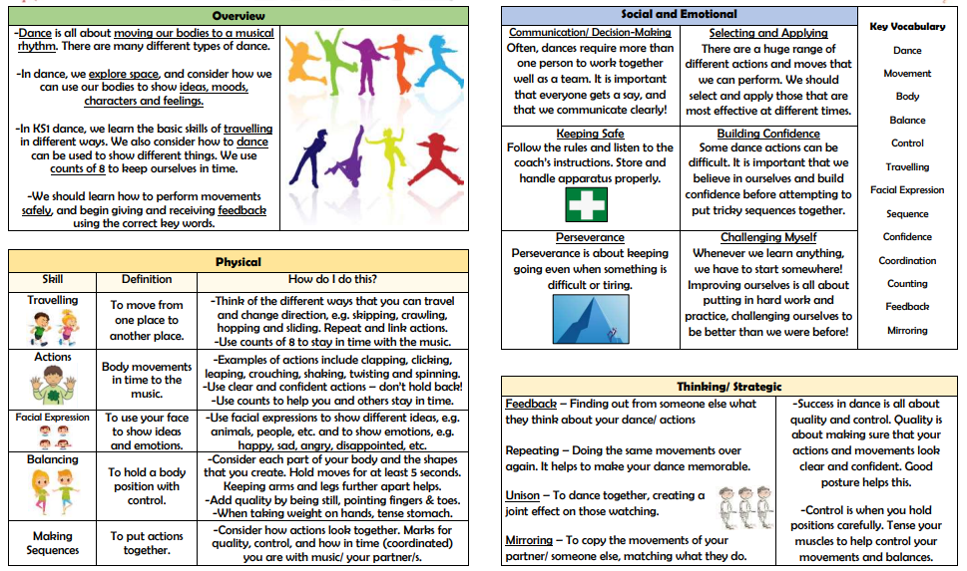
Year 2 PE – Dance Golden Thread: Freedom
Sky Objectives:
Can describe the ABC’s relating to movement.
Can identify why our bodies sweat and how this effects our need for water.

