Slide 1
Year 2 Music – Create own music Golden Thread: Freedom
Objectives and Sticky Knowledge
Previous Knowledge Recap: To listen carefully to a clapping pattern To listen carefully and clap back a repeated rhythm To clap back a repeated pattern correctly Use voice and instruments to make a series of different sounds To create and conduct a sequence of sounds for a desired effect To choose correct instruments and sounds to create happy sounding music To choose correct instruments and sounds to create sad sounding music To respond to a piece of music and describe how it made you feel
Land Objectives and Sticky Knowledge:
Links with the Golden Thread:​ | Links with CST and CKA Values Crown:​ ​
Order sounds to create a beginning, middle and an end | Create music in response to different starting points
I can create music with a steady pulse. I can create music which incorporates a rhythm. I can create music with a clear beginning middle and end. | I know how to add high and low sounds when using different instruments. I can represent the different starting points within a piece of music.

Slide 2
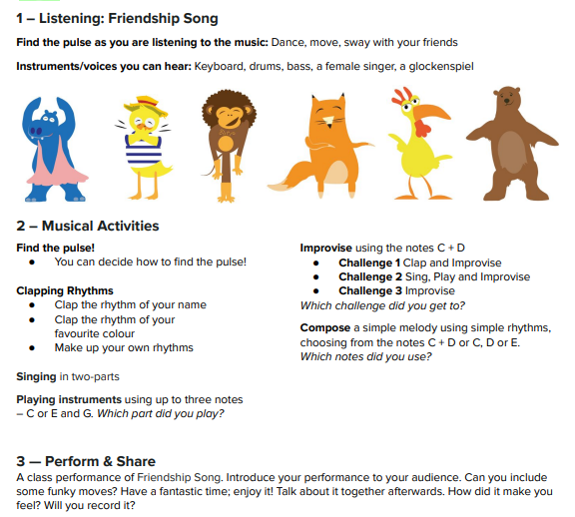
Year 2 Music – Create own music Golden Thread: Freedom
Sky Objectives:
Sing to communicate the meaning of words.
Mark the beat of a listening piece by tapping or clapping and recognising changes in tempo.
Use graphic symbols, dot notation and stick notation to keep a record of composed pieces.

