Slide 1
Year 6 Music Pentecost 1 Knowledge Organiser Golden Thread: Freedom
Objectives and Sticky Knowledge
Previous Knowledge Recap: 1. I can identify different parts of singing. 2. I can identify how the parts are different. 3. Know that to sing in unison, you must keep time with others.
Land Objectives and Sticky Knowledge:
Sea: Links with Golden Thread: | Links with CST and CKA Values Crown:
When listening to music, find the pulse. | Sing in an ensemble with the aim of producing a round sound with correct dictation and control of pitch. | Understand that when you improvise, you create your own piece within given boundaries. | Practise, rehearse and perform with an awareness of audience needs.
The pulse is the beat or rhythm. The pulse is usually a regular pattern. Use correct musical language to describe the music you are listening to. I can use tone, rhythm, pulse and volume to describe music. | I stand correctly with good posture. I can project my voice. I can follow direction from the adult to sing my part within a wider group. | I can identify the boundaries within which I am given. I can create lyrics within a given theme to fit a rhythm. | I stand correctly with good posture. I can project my voice. I can follow direction from the adult to sing my part within a wider group.

Slide 2
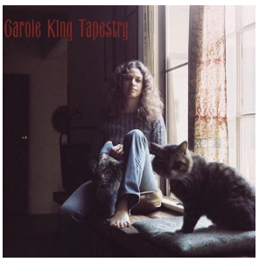
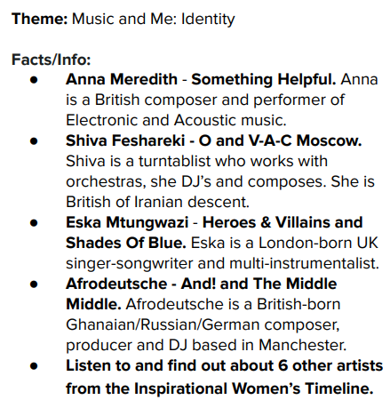
Year 6 Music Pentecost Knowledge Organiser
Key Vocabulary
Sky Objectives:
1. Sing expressively, with attention to dynamics and articulation.
2. Identify major and minor tonality, chord triads I, IV and V, and intervals within a major scale.
3. Compose song accompaniments, perhaps using basic chords.

