Slide 1
Year 2 History – Nelson Mandela and Mary Seacole Golden Thread: Freedom
Objectives and Sticky Knowledge
Previous Knowledge Recap: Know the name of a famous person, or a famous place, close to where they live. Famous local people: Stuart Broad, Rebecca Adlington and Sat Bains Know about a famous person from the locality and explain why they are famous: Florence Nightingale
Land Objectives and Sticky Knowledge:
Links with Golden Thread: Nelson Mandela’s battle for Freedom Mary Seacole - Her mother was Jamaican and her father was Scottish. At this time, lots of people had been forced into slavery. However, because Mary's father was white, she was born a 'free person'. | Links with CST and CKA Values Crown: Common Good – what is best for everyone? Solidarity - We are all one big family. Subsidiarity – People should have a say? Participation - We all want to work and contribute to our communities
Know about a famous person from outside the UK and explain why they are famous. – Nelson Mandela | Know about a famous person from outside the UK and explain why they are famous. – Mary Seacole
I know that Nelson Mandela was born in South Africa in 1918. He died in 2013. Nelson Mandela was the first black president of South Africa. Mandela dedicated his life to fighting for equal rights for people of all races. | She was born in 1805 in Jamaica to a free Jamaican mother and a Scottish father who was a soldier in the British Army. She learned about medicine from her mother, who ran a hotel and a nursing home in Jamaica. She travelled to Crimea during the Crimean War and opened the British Hotel to treat wounded and ill soldiers. She wrote an autobiography after the war, which was one of the first by a mixed-race woman.

Slide 2
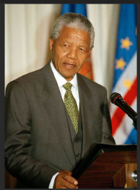
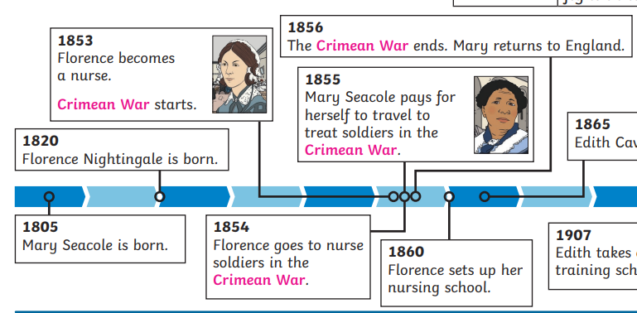
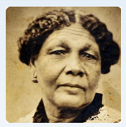
Year 2 History – Nelson Mandela and Mary Seacole Golden Thread: Freedom
Sky Objectives:
2.Understand that there are reasons why people in the past acted as they did and describe significant individuals from the past.

