Slide 1
Year 6 Geography Knowledge Organiser Golden Thread: Freedom
Objectives and Sticky Knowledge – Can I carry out an independent fieldwork enquiry?
Previous Knowledge Recap: The climate of an area is dependent on where it is located in relation to the tropics and the Equator. Humans can have a big impact on the world’s resources. Know the features of a specific biome. Deforestation is the deliberate clearing of forests by humans.
Land Objectives and Sticky Knowledge:
Sea: Links with Golden Thread: | Links with CST and CKA Values Crown:
To develop an enquiry question. | To determine the most effective data collection methods for fieldwork. | To plan a route for a fieldwork trip | To collect data, answer and present my findings for the enquiry question.
Explore changes and issues occurring in my local area. Determine my initial understanding of a local issue. Identify what I want to find out about a local issue. | Identify what data needs collecting to answer the enquiry question. Justify why I have chosen a data collection method. Design a data collection method. | Select the start and end of the route. Plot the points on the route where data will be collected. Identify any risks that may be encountered on the route. | Manage risks during fieldwork. Follow a route on an OS map. Record data using a variety of methods. Examine the data collect Add data to a digital map Draw a conclusion about what the data shows. Select data to include in a presentation. Present data using my chosen method. Discuss the process to collect data.

Slide 2
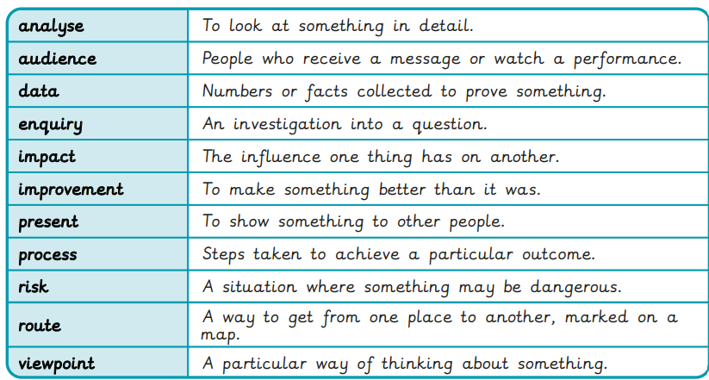
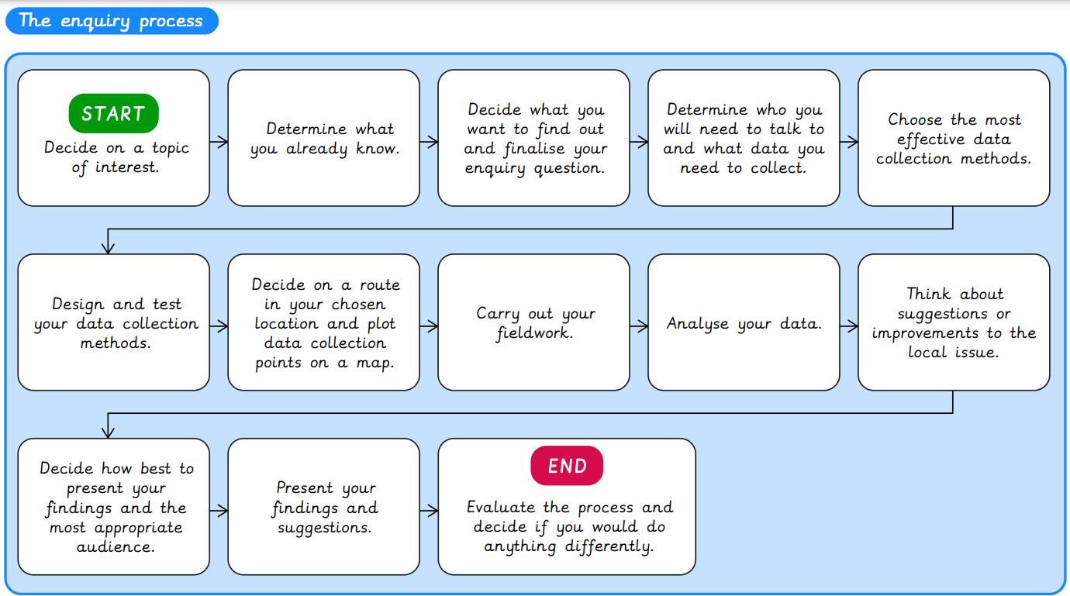
Year 6 Geography Knowledge Organiser
Sky Objectives:
1. Locate, describe and understand key aspects of deserts and climate zones.
2. Describe and understand the distribution of natural resources including energy, food, minerals and water
3. identify the position and significance of the Prime/Greenwich Meridian and time zones (including day and night)

