Slide 1
Year 2 Geography – Madagascar Golden Thread: Freedom
Objectives and Sticky Knowledge
Previous Knowledge Recap: Know the main differences between city, town and village - Y1 Know their address including postcode – Y1 Identify and recognise seasonal and daily weather patterns for hot and cold places in the world – Y1 Know the names of and locate the seven continents of the world - Y2 Know the names of and locate the five oceans of the world – Y2
Land Objectives and Sticky Knowledge:
Links with Golden Thread: | Links with CST and CKA Values Crown:
Know the main human and physical differences between a place in England and that of a small place in a non-European country. | Identify the following physical features: mountain, lake, island, valley, river, cliff, forest and beach. | Explain some of the advantages and disadvantages of living in a city or village.
I can compare the physical features of a place in England to a place in Madagascar. I can identify human and physical features of a place in England to a place in Madagascar. | Identify the above physical features on a map of England and a map of Madagascar | I understand that villages are quiet and a smaller community. I know that in villages, people in the community know each other and work together. I know that in villages, there are fewer services and things to do and cities are larger with more services and entertainment. Cities are noisy with lots of traffic.

Slide 2
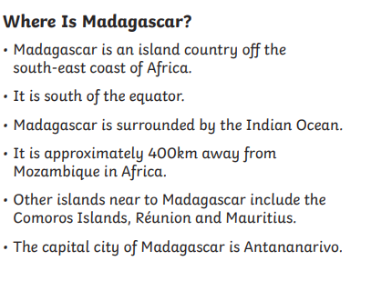
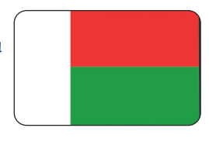
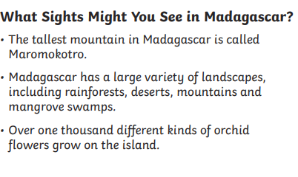
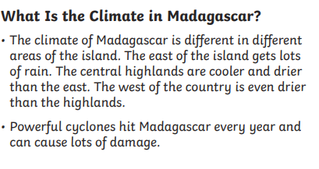
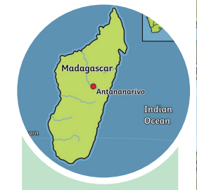
Year 2 Geography – Madagascar Golden Thread: Freedom
Sky Objectives: ​Identify and explain key physical features of an environment, including the location of hot and cold areas of the world in relation to the Equator and the North and South Poles.

