Slide 1
Year 2 D&T – Textiles - pouches Golden Thread: Freedom
Objectives and Sticky Knowledge
Previous Knowledge Recap: To cut and join fabric together using glue, pins or staples To test and explore different methods of joining fabrics To create a paper design of the desired end product To select the correct colours/materials/features to create the end product To attach any additional features using glue/pins/staples
Land Objectives and Sticky Knowledge:
Links with ‘Sustainability and Stewardship’ Golden Thread:​ | Links with CST and CKA Values Crown:​
Develop and sketch design ideas using a template. | Thread a needle, sew a running stich, prepare fabrics for sewing and tie a secure knot. | Discuss the making process and finished product, review others final outcome. | Identify parts of a needle (point and eye) understand the alternative ways of joining fabrics and embellishments.
I can design a pouch I can design decorations for my product I can evaluate my own designs | I can thread a needle I can sew a running stitch I can use neat and evenly spaced stitches to join fabric I can sew neat, even stitches I tie a knot at either end of the thread | I can remember how to use a template I can cut fabric neatly I can pin fabric accurately | I can join items using fabric glue or stitching I can decorate fabric using different items

Slide 2
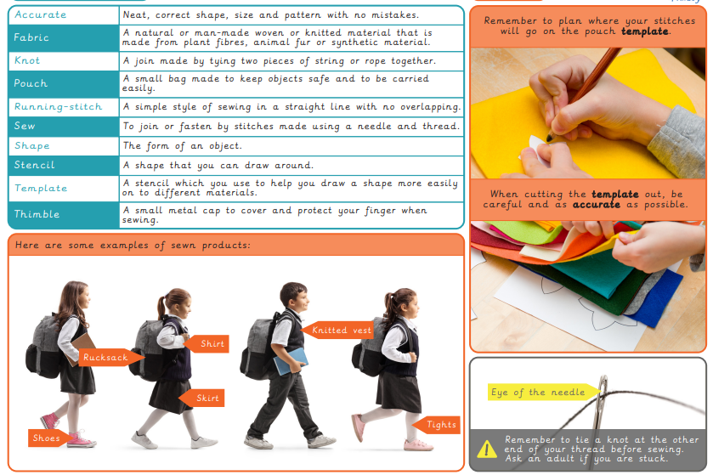
Year 2 D&T – Textiles - pouches Golden Thread: Freedom
Sky Objectives: ​
Generate and communicate ideas using sketching and modelling.​
Make a structure according to a design criteria.​
Evaluating own design against a design criteria given.

