Slide 1



Year 2 Computing – Pictograms Golden Thread: Freedom
Objectives and Sticky Knowledge
Previous Knowledge Recap To be able to describe objects using labels To be able to count and group objects To be able to describe an object’s and its properties
Land Objectives and Sticky Knowledge:
Links with Golden Thread:​ | Links with CST and CKA Values Crown:​
Select objects by attribute and make comparisons | Recognise that people can be described by attributes | Explain that we can present information using a computer
I can tally objects using a common attribute I can create a pictogram to arrange objects by an attribute I can answer ‘more than’/’less than’ and ’most/least’ questions about an attribute | I can choose a suitable attribute to compare people I can collect the data I need I can create a pictogram and draw conclusions from it | I can use a computer program to present information in different ways I can share what I have found out using a computer I can give simple examples of why information should not be shared

Slide 2
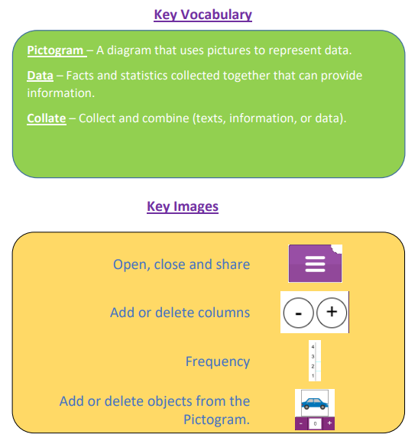
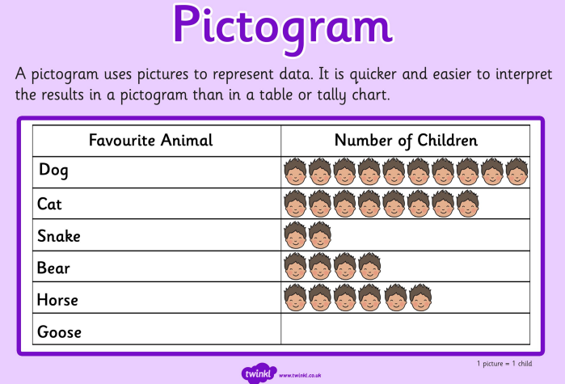
Year 2 Computing – Pictograms Golden Thread: Freedom
Sky Objectives: ​
Create, store and retrieve digital content.

