Slide 1
Year 2 Computing – Digital Music Golden Thread: Freedom
Objectives and Sticky Knowledge
Previous Knowledge Recap To be able to make marks on a screen and explain which tools I used To use the paint tools to create a picture To be able to make appropriate colour/shape/line choices To be able to change the brush size and colour
Land Objectives and Sticky Knowledge:
Links with Golden Thread:​ | Links with CST and CKA Values Crown:​
To use a computer to create a musical pattern | To create music for a purpose | To review and refine our computer work
I can identify that music is a sequence of notes I can explain how my music can be played in different ways I can refine my musical pattern on a computer | I can create a rhythm which represents an animal I’ve chosen I can create my animal’s rhythm on a computer I can add a sequence of notes to my rhythm | I can review my work I can explain how I changed my work I can listen to music and describe how it makes me feel

Slide 2
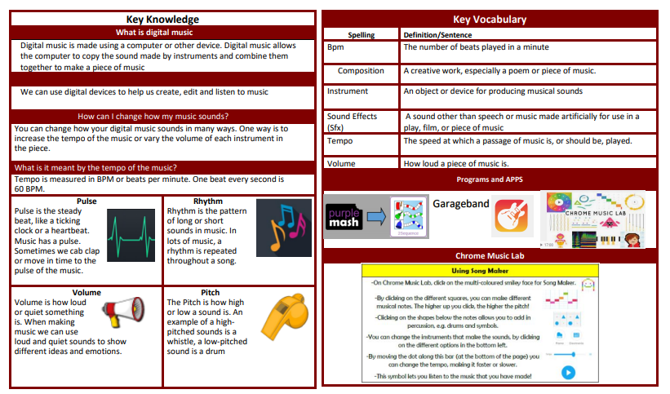
Year 2 Computing – Digital Music Golden Thread: Freedom
Sky Objectives: ​
Create, store and retrieve digital content.

