Slide 1
Year 2 Art – Printing and Salt Dough Golden Thread: Freedom
Objectives and Sticky Knowledge
Previous Knowledge Recap: To use a pair of scissors correctly To understand how to roll a material To understand what is meant by coiling To create a end product by cutting, rolling and coiling material
Land Objectives and Sticky Knowledge:
Links with ‘Freedom’ Golden Thread: | Links with CST and CKA Values Crown:
Know how to create a printed piece of art by rubbing, pressing, rolling and stamping. | Know how to make a clay pot (salt dough) – to understand how to manipulate salt dough (water/flour – consistency)
I can create printed pieces by pressing a range of objects in sequence. I can identify whether rubbing, rolling or pressing can create the best effect. I can create patterns with colour, size and shape. | I know that adding water will make the mixture smooth. I can use my fingers and thumbs to mould the correct shape for a thumb pot. I can use rolling and pressing to create a coil pot. I know that adding water helps to merge different parts of clay together.

Slide 2
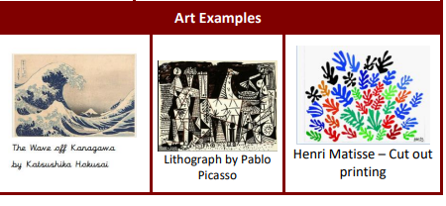
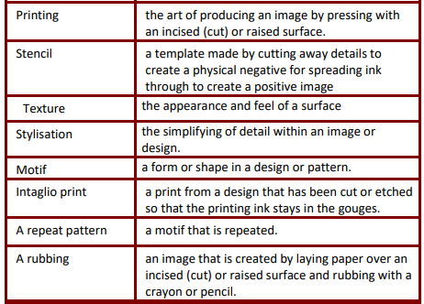
Year 2 Art – Printing and Salt Dough Golden Thread: Freedom
Sky Objectives:
3.To create a shape using salt dough and to understand how to manipulate salt dough (how to use flour/water to get the right consistency)

