Slide 1
Year 2 Art - Monet Golden Thread: Freedom
Objectives and Sticky Knowledge
Previous Knowledge Recap: Describe what can be seen and give an opinion about the work the artist Mondrian. Y1 Know how to mix paint to create all the secondary colours Y2 – advent Know how to create brown with paint Y2 – advent Know how to create tints with paint by adding white and know how to create tones with paint by adding black Y2 - advent
Land Objectives and Sticky Knowledge:
Links with ‘Freedom’ Golden Thread: | Links with CST and CKA Values Crown:
To use watercolours and know how to create the strength of colour you want | To select the appropriate paint brush to use | Suggest how artists have used colour, pattern and shape | Know how to create a piece of art in response to the work of another artist
I can mix watercolours using primary and secondary colours with water | I can experiment with a variety of brushes to select the best one for the job. | I can explain that Monet experimented with a new style of art, ‘impressionism.’ Impressionism is a style of painting using short, quick brushstrokes and unblended colours. Monet worked on a series of paintings of the same object but from different viewpoints. Monet’s painting reflects light in nature. | I can paint using short brushstrokes. I can paint without blending colours.

Slide 2
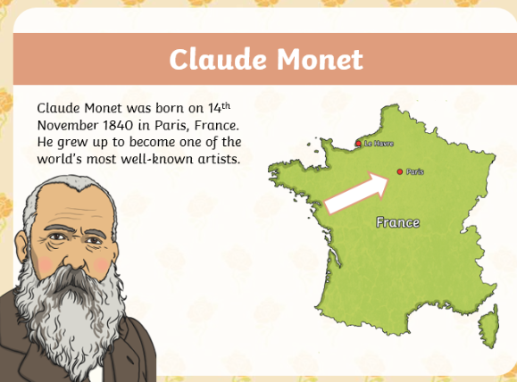
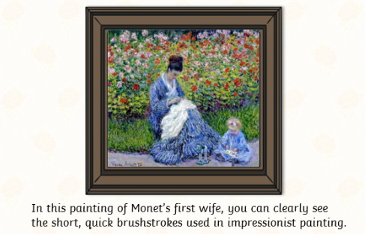
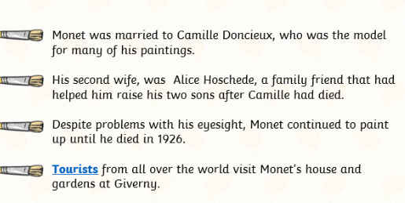
Year 2 Art - Drawing Golden Thread: Freedom
Sky Objectives:
To make a two-part colour wheel showing primary and secondary colours.

